Slide 1
Curriculum and Course Development in the College of LAS
Stephen R. Downie
Associate Dean for Curricula and Academic Policy

Slide 2
LAS Courses and Curricula Committee
Standing committee of the College
Faculty members serve staggered two-year terms and represent the 8 LAS electoral groups
Includes four additional members (undergrad student, grad student, academic professional, specialized faculty) with full voting rights
LAS Associate Dean for Curricula and Academic Policy leads committee

Slide 3
LAS Courses and Curricula Committee
Meets approximately every two weeks throughout the semester
Reviews all new and revised LAS courses (including those submitted for General Education credit) and new LAS programs
Agenda and materials are made available in Box one week prior to each meeting

Slide 4
Course Review
Some items to consider when reviewing proposals:
Is the course described clearly? Does it follow the required guidelines for the Academic Catalog?
Is there overlap with other courses on campus?
Is the level/credit appropriate given the course workload?
Does the course syllabus follow Office of the Provost and LAS required guidelines?
Are students graded using multiple measures?

Slide 5
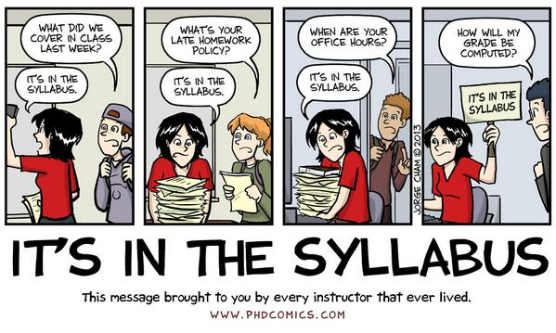
LAS Course Syllabus Requirements
Designed with student and faculty audiences in mind, and includes specific accreditation requirements

Slide 6
Course Review
Committee Actions
Approve (with majority decision)
Approve with revisions (typically minor)
Reexamine the course proposal and/or syllabus once revisions have been made

Slide 7
Course Review
After CCC review:
100-, 200-, and 300-level courses are forwarded to the Office of the Provost
Courses proposed for General Education credit are also reviewed by the LAS General Education Committee and, once approved by campus, the General Education Board
400- and 500-level courses that award graduate credit are forwarded to the Graduate College

Slide 8
Curricula Review
Units submit proposals for new programs using the CIM-P system
LAS CCC evaluates the proposal on its academic merits. Does it follow required LAS and campus guidelines?
LAS Dean’s Cabinet reviews for fiscal implications (if any)
New programs are also reviewed by the LAS Executive Committee

Slide 9
Curricula Review
Once approved, graduate curricula are sent to the Graduate College; all others are sent to the Office of the Provost for submittal to the Senate Educational Policy Committee (EPC)
EPC conducts its review; upon approval, proposal is presented to the Academic Senate
After Senate approval, Board of Trustees and IBHE approvals are required

Slide 10
Undergraduate Certificate Review
Highlights a narrower field than concentration or a minor; generally most appropriate for students across a variety of majors
3-4 courses (one core course) and 9-15 hours
Reviewed and approved by LAS CCC only

Slide 11
Resources
Requirements for LAS Course Syllabi
https://las.illinois.edu/system/files/inline-files/LAS%20Syllabi%20Requirements_1.pdf
Checklist for LAS Course Syllabi
https://las.illinois.edu/system/files/inline-files/Checklist%20for%20LAS%20Syllabi%20%28LAS%20CC%29_0.pdf
Approval Processes for LAS Courses and Curricula
https://las.illinois.edu/faculty/courses
https://las.illinois.edu/faculty/curricula

Slide 12
Resources
Office of the Provost Guidelines on Proposing New Courses
http://provost.illinois.edu/policies/policies/courses/proposing-new-courses/
Office of the Provost’s Guidelines for New or Revised Programs
https://provost.illinois.edu/education-1/courses-programs/guidelines-for-new-or-revised-programs/
Office of the Provost’s Courses and Programs
https://provost.illinois.edu/education-1/courses-programs/

Slide 13
Contact Information
Stephen R. Downie
Associate Dean for Curricula and Academic Policy, sdownie@illinois.edu
Beth McKown
Extra Help Office Specialist, bmckown1@illinois.edu
TBD
Assistant Director, search conducted Fall 2024

